Slide 1

noteIt – Product Backlog Presentation
Developer Team : cubeX
Client team : N-DAARP
SQA Team : N-Li8
Presenter : Ayushi Agrawal
Date : 08-09-2015

Slide 2
Contents
Features proposed by clients
Role assignment
Roadmap
User Story
Tools
Backlog
Technical flow

Slide 3
Features proposed by client
Create task and prioritize them
Facility to create notes and add documents
Ability to customize the task and deadlines
Integration of tasks with calendar to provide reminders
Basic Framework for type of task
Dynamically changing priorities of task
Color coding as per priorities of task

Slide 4
Role Assignment
Team Lead - Aasif Sheikh
Developer - Vishakha Gupta
GUI Designer- Farha Naaz
Bussiness Analyst - Ayushi Agrawal
Database Admin- Pallavi Panchal
Tester- Kunal Mehta

Slide 5
Roadmap
share tasks with friends and group task
Project task management and dynamic priority
Login, general task and list task management
15th sep.
15th Oct.
27th Oct.

Slide 6
User Story
User Story 1 : Login Feature
Email Id
Name
Password
User Story 2 : Add tasks/notes
User will be able to create new tasks and notes
User Story 3 : Remove tasks/notes
User will be able to delete tasks and notes
User Story 4 : Update tasks/notes
User will be able to update tasks/notes
User Story 5 : Set reminders
User will be able to set reminders at note level as well as at task level
Login Feature
-----------------
-------------------
Add tasks/notes
-----------------------
-----------------------
Remove tasks/notes
-------------------
--------------------
update tasks/notes
-------------------
---------------------
set reminders
------------------
------------------

Slide 7
Backlog
Story | Priority | Estimates
Login Feature | 1 | 1
Add tasks/notes | 2 | 3
Remove tasks/notes | 3 | 1
update tasks/notes | 4 | 2
set reminders | 5 | 2

Slide 8

Tools
Andriod studio for development
Why Android studio instead of Eclipse???
Drag and Drop GUI Design
IntelliJ IDEA platform
Google Cloud Platform
User Interface
Advanced Android code completion

Slide 9

GitHub as repository
Why?
open source community
Friction-less development across teams
Powerful integrations

Slide 10

Sqlite for database
Why?
faster then MySQL/PostgreSQL.
Easily movable database.
Security
Atomic commit and rollback protect data integrity.

Slide 11
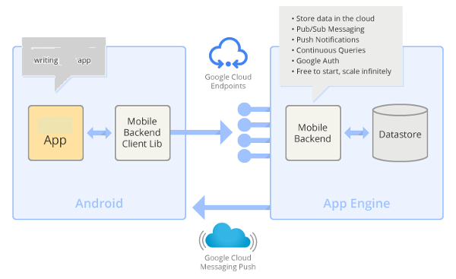
TECHNICAL FLOW

Slide 12
Thank You
Any Queries????

